Slide 1
PROJECT CENTRIC LEARNING
SMART PRICE COMPARATOR
SUBMITTED TO
Dr.Sujeet.s.jagtap
SUBMITTED BY
SRAVYA.M
(23BTRCL208)

Slide 2
LIST OF CONTENTS
Introduction
Abstract
Objective
System Architecture / Ideation Map
Module Implementation
Results and Discussions
Conclusion
References

Slide 3
INTRODUCTION
• What is a Price Comparator?
A price comparator is an online tool that collects and compares prices of the same
product from multiple e-commerce websites to help users find the best deal.
• Importance:
Online shopping offers many options, but comparing prices manually is time-
consuming. A price comparator saves time and helps users make smart buying
decisions by showing the best prices in one place.
• Brief Overview:
Our project is a full-stack web application that aggregates product prices in real-time from different stores. It offers filtering options and price alerts, making it easy for users to compare and choose the best price quickly

Slide 4
ABSTRACT
This project presents a full-stack web application designed as a Price Comparator tool that enables users to efficiently compare product prices across multiple e-commerce platforms. The system aggregates real-time pricing data and provides users with intuitive filtering options, ensuring quick identification of the best available deals. In addition to price comparison, the application offers features such as price alerts and a user-friendly interface to enhance the online shopping experience. By reducing the time and effort required for manual comparisons, this tool empowers users to make cost-effective purchasing decisions while highlighting the significance of automation and data integration in modern e-commerce solutions.

Slide 5
OBJECTIVE
• Build a web app that aggregates product prices from multiple e-commerce sites.
• Provide real-time price comparisons and updates.
• Offer advanced filters like price range, brand, seller rating, and delivery options.
• Enable users to set alerts for price drops and special deals.
• Design an intuitive, user-friendly, and responsive interface.

Slide 6
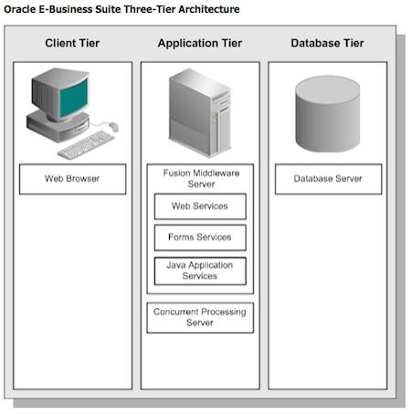
SYSTEM ARCHITECTURE

Slide 7
MODULE IMPLEMENTATION
User Interface – Search, filter, and display products. Data Collection – Fetch prices via APIs/Web Scraping. Data Processing – Clean, aggregate, and normalize results. Price Comparison – Show best deals with sorting/filtering.
Price Alert – Notify users of price drops.

Slide 8
RESULTS AND DISCUSSIONS
Prices fetched in real-time from multiple sites.Lowest price highlighted for quick decisions.Users save time vs manual comparison.Price alerts improve buying efficiency.Simple and user-friendly interface.
Discussion: Centralized comparison improves shopping experience; can be expanded to more platforms in future.

Slide 9
CONCLUSION
The Price Comparator effectively simplifies online shopping by providing real-time price comparisons. It helps users save time and money through quick decision-making and price alerts. The project highlights the role of automation and data integration in improving e-commerce solutions. Future work can focus on adding more platforms and enhancing accuracy for broader usability.

Slide 10
REFERENCES
• Frontend add css html
• Database No sql
• Backend javascript
• Typescript react js

Slide 11
THANK YOU

